Slide 1

Insider Threat Awareness
Combating the ENEMY Within
Mr. Richard Barnard
Command Security Manager
MCIEAST-MCB Camp Lejeune
Notes:
The insider threat is not new. Since the American Revolution, ‘trusted agents’ of the United States have betrayed our Nation. Today the opportunities for betrayal are easier, based on the increase in the number of personnel with access to sensitive information; the ease at which information can be transmitted (internet) and the growing demand from multiple ‘customers’. Presidential Directive issued for the development and implementation of Insider Threat Programs for all Executive Departments and Agencies. DoD 5205.16, dated 30 Sep 14, is in response to this directive. During this session will take a look at the insider threat and the role you play in combating this threat. The intent of this training session is not to make you a counterintelligence agent, but to increase your awareness of the insider threat.

Slide 2
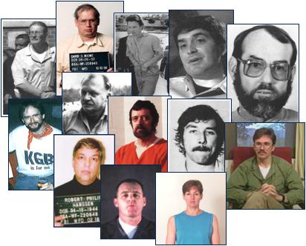
Insider Threat Awareness
What is an Insider Threat?
Indicators of Insider Threat
General Suspicious Behaviors
Reporting Potential Insider Threats
Self-Graded Examination
Notes:
We will discuss these topics and the various elements within these topics which will help you to understand how to identify and report an insider threat. At the end of this slide presentation, we will take a look at a video produced by the FBI which will take us through each of these elements and test your ability to identify these elements in the storyline of this video.

Slide 3
What is an Insider Threat?
A person using his or her authorized access, wittingly or unwittingly, to do harm to the national security and industry.
Insider Threats also include:
Criminal activity – including theft and fraud
Safety – including active shooter incidents
Financial harm to industry – stealing unclassified, but sensitive or proprietary information
Notes:
‘Insiders’ have caused more damage to our national security than trained, foreign professional intelligence officers. Why – because we are looking for them and have implemented programs to identify and mitigate or prevent the adverse impact on national security. More than ever, we need to start looking within for threats to our national security.
Wittingly (fully aware of the damage you could be causing) or unwittingly (don’t have a clue if what you are doing could be damaging) – IMPACT IS THE SAME.
Authorized Access – doesn’t have to be classified. It could be unclassified, sensitive, personal or financial information that a person has access to that could be detrimental.

Slide 4
Results of Insider Threats:
Loss/compromise of classified, export controlled, or proprietary information
Weapons systems cloned, destroyed, or countered
Loss of technological superiority
Economic loss
Loss of life
Notes:
The relative impacts of the insider threat cannot be measured in dollars alone, as they can be far-reaching, long-term and fatal.
Do you think any of these apply to By Light?

Slide 5


First Line of Defense – YOU!
Recognizing and Reporting Potential Insider Threats:
  Recruitment
  Information Collection
  Information Transmittal
  General Suspicious Behaviors
Notes:
We will take a look at each of these areas to gain a great understanding of your role in identifying and reporting the insider threat.
You could call this the modus operandi.
Usually, the recruitment starts and ends customer with a foreign agency.

Slide 6
Insider Threat Indicators
Recruitment
Unreported request for critical assets outside official channels
Unreported or frequent foreign travel
Suspicious foreign contacts
Contact with individuals known or suspected to be associated with foreign intelligence, security, or terrorism
Unreported offers of financial assistance, gifts, or favors by foreign national or stranger
Suspected recruitment of employee by foreign or domestic competitive companies
Notes:
It’s not always who you know that can help you get what you want… it’s what they know on you. You should always attempt to maintain a low profile when talking with strangers and report any incidences of attempts by personnel you suspect may be targeting you.
How does someone get recruited? Typically, a weakness is identified and targeted. Money, sex or pride (power).
What kind of information do you post on social media that could be targeted?

Slide 7
Insider Threat Indicators (cont.)
Information Collection
Using unclassified medium to transmit classified materials
Discussing classified materials on a non-secure telephone
Removing classification markings from documents
Unauthorized downloading or copying of files
Keeping classified materials/critical assets in unauthorized locations
Attempting to or accessing sensitive information, critical assets, or information systems when not required or without authorization
Asking others to obtain critical assets to which the requestor does not have authorized access
Operating unauthorized cameras, recording devices, computers, or modems where critical assets are stored/discussed/processed
Notes:
Unauthorized downloading/copying of files (especially employees who have given notice of termination of employment).
What about the person who has been given a termination notice, or knows they about to get one, and all of a sudden they are the best workers ever… staying late each night, taking on more responsibility (outside the scope of their normal duties), just a little more curious about things than before??

Slide 8
Insider Threat Indicators (cont.)
Information Transmittal
Removing critical assets from the work area without authorization
Extensively reproducing/transmitting critical asset-related information beyond job requirements
Discussing critical asset-related information in public or on a non-secure telephone
Using an unauthorized fax or computer to transmit classified information
Attempting to conceal foreign travel – business or personal
Improperly removing classification markings from documents
Notes:
As I stated earlier, the ease of transmitting information has made it more complicated to detect when an insider threat may have occurred.
Electronic transmissions, hand-carrying.

Slide 9
General Suspicious Behaviors
Attempts to expand access to critical assets by repeatedly volunteering for duties beyond normal job responsibilities
Performs repeated or unrequired work outside of normal hours, especially unaccompanied
Repeated security violations
Engagement in illegal activity or requesting others to do so
Unexplained or undue affluence explained by inheritance, luck in gambling, or some business venture
Sudden reversal of financial situation or repayment of large debts
Notes:
One or two indicators does not necessarily mean a person is an insider threat, just as not every suspicious circumstance or behavior represents a spy within our midst. But, these are indicators that could raise an eyebrow or two.

Slide 10

General Suspicious Behaviors (cont.)
Attempts to compromise personnel with access to critical assets special treatment, favors, gifts, money or other means
Displays questionable loyalty to U.S. Government or company
Behaviors associated with disgruntled employees:
  Conflicts with supervisors and coworkers
  Decline in work performance
  Tardiness
  Unexplained absenteeism
Notes:
Sometimes, it might be your gut just talking to you, where something just doesn’t seem right.
Sometimes folks do get unhappy or frustrated… doesn’t necessary mean they are an insider threat – but, could be someone uses that to target them.

Slide 11
If you suspect a potential Insider Threat You MUST report it!
Contact your:
  MCIEAST Security Manager, Mr. Richard Barnard
    e-mail: richard.barnard@usmc.mil
    phone: 910-451-3568/3563
Notes:
Your security manager should be your first stop, if you suspect an insider threat. It may not be easy, but it is the right thing to do.
Questions you may ask yourself…
How much or too little should be reported? Remember – you may have only a small part of the bigger picture – but, it is that small piece that could bring everything into focus.

Slide 12
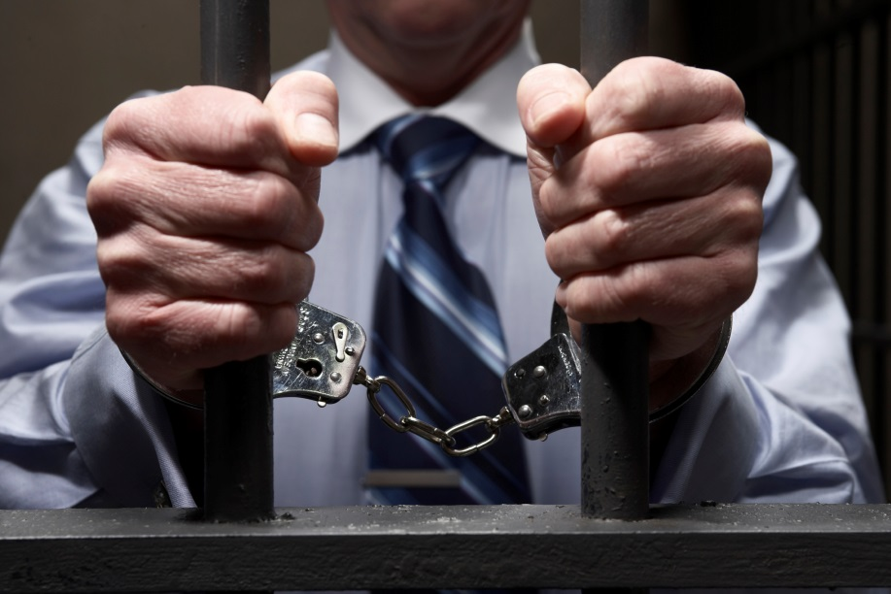
Failure to Report
  Risks YOUR physical security, the Information Security of your organization, and the security of the United States!
  Risks YOU:
  Losing your security clearance
  Losing your employment
  Facing possible criminal charges
Notes:
If you have to consider the fact that if you don’t report it, no one else will. It is up to you.
You don’t want to become an over-zealous reporter, but you also don’t want to not report something and later find out it was too late.

Slide 13

Remember –
YOU are the First Line of Defense!
If you suspect a potential Insider Threat,
You must report it!
Notes:
Reporting is not an option, it is an obligation. MCIEAST-MCB Camp Lejeune military, civilian, and contractor personnel shall report adverse information coming to their attention concerning any of their cleared employees. Reports based on rumor or innuendo should not be made. The subsequent termination of employment of an employee does not obviate the requirement to submit this report.

Slide 14
Actual Occurrences of Insider Threats
DSS Counterintelligence Reports
  http://www.dss.mil/isp/count_intell/ci_reports.html
  DHS US CERT and FBI
  http://www.fbi.gov/news/stories/story-index/cyber-crimes
  https:// www.cert.org/insider-threat/
Notes:
This concludes the presentation of the training material. We will now look at a video produced by the FBI back in 2011 which portrays an insider threat that occurred within the FBI. Although the actual incident is not true, it does incorporate elements from various, actual incidences involving FBI personnel. As you watch the video, see how many ‘indicators’ you can identify. At the conclusion of the video, and if we have time, we will engage in a Q&A to see how much you learned and give you an opportunity share what you learned. Keep in mind, the FBI only invested $300K in the production of this video, so you will not see any ‘name brand’ actors. Some of the indicators will be easier to pick up on than others and you may see them repeated. The intent of the video is not to make you a counterintelligence agent, but to make you aware of how things can happen when a person is vulnerable and how we all have a responsibility and obligation to report suspicious behavior.

Slide 15
Q&A
General comments about the video… Do you believe it provided some insight into the various elements involved with the Insider Threat?
How do you believe this person was recruited?
What were some of the suspicious behaviors observed by the co-workers that indicated something wasn’t right?
Could something like this happen to By Light? How/Why?
What do you believe was the end result for the other team members?

