Slide 1

Espionage Indicators
Briefing
U.S. Department of Commerce
Office Of Security (OSY)
1
Security is Everyone's Responsibility
Updated 11/25/14

Slide 2
Who Must Have Briefing
Any employee that may sponsor a Foreign National Visitor or Guest to a DOC Facility/Activity for any reason.
All Department Sponsors who will act as a sponsor to a Foreign National Visitor.
    A departmental sponsor is a US Citizen employee of the department responsible for the day to day activities associated with the successful accomplishment of a foreign visit and for taking all reasonable steps to protect classified, Sensitive But Unclassified (SBU), or otherwise controlled, proprietary, or not for public release data, information or technology from unauthorized physical, visual, and virtual access by a Foreign National Visitor of Guest.
2
Security is Everyone's Responsibility

Slide 3
Espionage Indicators
Are signs that an individual, either a DOC employee or a Foreign National Visitor/Guest may be involved in illegal collection of information on behalf of a foreign intelligence organization.
3
Security is Everyone's Responsibility

Slide 4
Potential Indicators of Espionage
Disgruntlement with the U. S. Government strong enough to cause an individual to seek or wish for revenge.
Any statement that suggests conflicting loyalties may affect the proper handling and protection of sensitive information.
Active attempts to encourage others to violate laws or disobey security policies and procedures.
Membership in, or attempt to conceal membership in, any group which:
    Advocates the use of force or violence to cause political change within the U.S.
    Has been identified as a front group for foreign interests
    Advocates loyalties to a foreign interest
4
Security is Everyone's Responsibility

Slide 5
Potential Indicators of
Information Collection
Asking others to obtain or facilitate access to classified material or unclassified but sensitive information which one does not have authorized access.
Obtaining or attempting to obtain a witness signature on a classified document destruction record when the witness did not observe the destruction.
Offering money to a person with a sensitive job in what appears to be an attempt to entice that person into some unspecified illegal activity.
Undue curiosity or requests for information about matters not within the scope of the individuals job or need to know.
Unauthorized removal or attempts to remove unclassified, classified, export-controlled, proprietary, or other protected material from the work area
5
Security is Everyone's Responsibility

Slide 6
Potential Indicators of
Information Collection
Retention of classified, export-controlled, proprietary, or other sensitive information obtained through previous employment without the authorization or the knowledge of that employer.
Extensive, unexplained use of copier, facsimile, or computer equipment to reproduce or transmit unclassified, sensitive, classified, proprietary, or export-controlled material.
Taking classified or sensitive materials home purportedly for work reasons, without proper authorization.
Working odd hours when others are not in the office or visiting other work areas after normal hours for no logical reason.
Bringing cameras or recording devices, without approval, into areas storing classified, sensitive, or export-controlled material.
6
Security is Everyone's Responsibility

Slide 7
Potential Indicators of
Illegal Income
Unexplained affluence, or life style inconsistent with known income. Notably, sudden purchase of high value items or unusually frequent personal travel, which appears to beyond known income. Sudden repayment of large debts or loans, indicating sudden reversal of financial difficulties.
Joking or bragging about working for a foreign intelligence service, or having a mysterious source of income.
7
Security is Everyone's Responsibility

Slide 8
Other Potential Indicators of
Concerns
Behavior indicating concern that one is being investigated or watched, such as actions to detect physical surveillance, searching for listening devices or cameras, and leaving “traps” to detect search of the individuals work area or home.
Any part-time employment or other outside activities that may create a conflict of interest with one’s obligation to protect classified or sensitive but unclassified information.
NOTE: The existence of one or two of the aforementioned factors does not necessarily mean that a person is engaged in espionage activity. However, the risk that someone may be involved in espionage against the DOC increases when these elements are present.
8
Security is Everyone's Responsibility

Slide 9
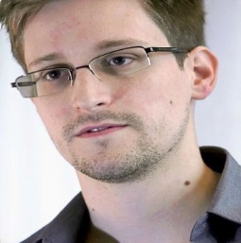
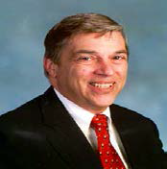
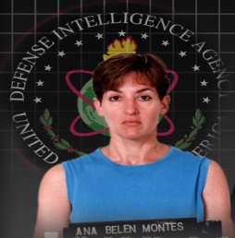
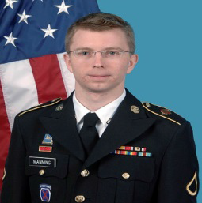
Classified Information and Insider Threat: What Is It And Why It Matters
Insider Threat is an abuse of authorized access to any U.S. Government resource (primarily classified information or systems) by an individual which harms the security of the United States.
What Can Happen:
Disgruntled employees can compromise our information or systems
Foreign intelligence services and non-governmental entities can target, recruit, or exploit insiders
What’s At Stake:
•The Department’s mission
•Classified and sensitive information
•Our networks (classified and unclassified)
•Economic advancement
9
Security is Everyone's Responsibility

Slide 10
Classified Information and Insider Threat: Signs & Indicators
Insider Threat Indicators: Certain conduct by a co-worker which could merit additional scrutiny and reporting. • Seeking access to classified information beyond their need-to-know • Mishandling or unexplained storage of classified or sensitive material • Unauthorized downloading or removing classified information from the workplace • Mounting debt or unexplained affluence, unreasonable job dissatisfaction, unusual sense of victimization, significant interpersonal conflicts, or expressions of divided loyalties between the U.S. and another country
Elicitation: A trained adversary can redirect a conversation to sensitive topics without using questions, and often without the target being aware of what’s really happening.
Recruitment: People abuse access for personal reasons and adversaries look to leverage them. Basic signs of recruitment may include: • Person(s) who appear to be collecting information about you beyond the situation or setting • Asking you to do something unrelated to your job duties • Asking you to do something that is not allow by Departmental rules or U.S. Law
These methods and indicators can occur online as well as in person
Security is Everyone's Responsibility
10

Slide 11
Classified Information and Insider Threat: You Can Make The Difference
Awareness: Regardless of whether or not you access classified or sensitive information, your awareness about possible insider threats may prevent enormous damage
Recruitment: • Don’t assume a concern is unimportant – immediate reporting can be the key to early detection • All employees are required to promptly and directly report to their supervisor and OSY an suspected activities or conduct that could represent a potential insider threat • Reported information will be safeguarded in accordance with all applicable laws, whistleblower protections, and civil liberty/privacy policies
Other Obligations: Remember your additional reporting obligations involving: foreign travel, foreign contacts, and foreign national visitors
When In Doubt, Report It!
Security is Everyone's Responsibility
11

Slide 12
WHEN IN DOUBT….REPORT IT!!!
If you believe that someone may be contemplating espionage or other criminal activity, or has taken steps to initiate it, you are obligated to immediately report this information to the Office of Security Headquarters through your servicing security office.
Security is Everyone's Responsibility
12

Slide 13
If your reporting helps stop a case of espionage you may be eligible for a reward of up to…
$500,000
13
Security is Everyone's Responsibility

Slide 14
Espionage Indicators Briefing
The following slide has the Espionage Indicators Briefing Acknowledgement Statement
Please print the Acknowledgement Statement and fax to our office.
U.S. DOC Western Region Security Office
Fax: (206) 526-4543
14
Security is Everyone's Responsibility

Slide 15
Simply double click the picture to access the form
15
Security is Everyone's Responsibility

Slide 16
Questions?
16
Security is Everyone's Responsibility

Slide 17
WRSO CONTACT INFORMATION
Michael Shearin
Western Region Security Office
Phone: (206)526-6674
Fax: (206)526-4543
Cell: (206) 396-2346
mshearin@doc.gov
Micahael.Shearin@noaa.gov
17
Security is Everyone's Responsibility

